Slide 1
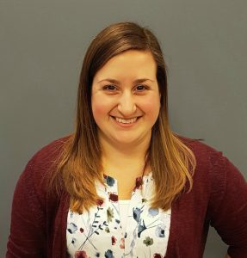
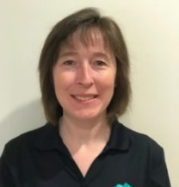
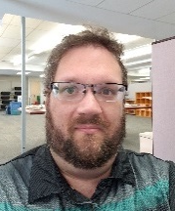
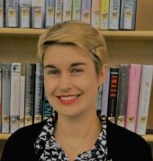
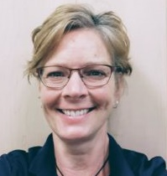
SMALL BUILDINGS, BIG DREAMS: hosting a Hulk-sized Comic Con in an Ant-Man-sized library
JODIE MANDARINO Youth Services Librarian
NANCY KUHL Branch Program Coordinator JEREMY CLARK Digital Initiatives Coordinator
Nadia Danyluk Deputy Chief Librarian
SHARON WAGENAAR Youth Services Specialist
Halton Hills
Bruce County
Owen Sound & North Grey Union

Slide 2
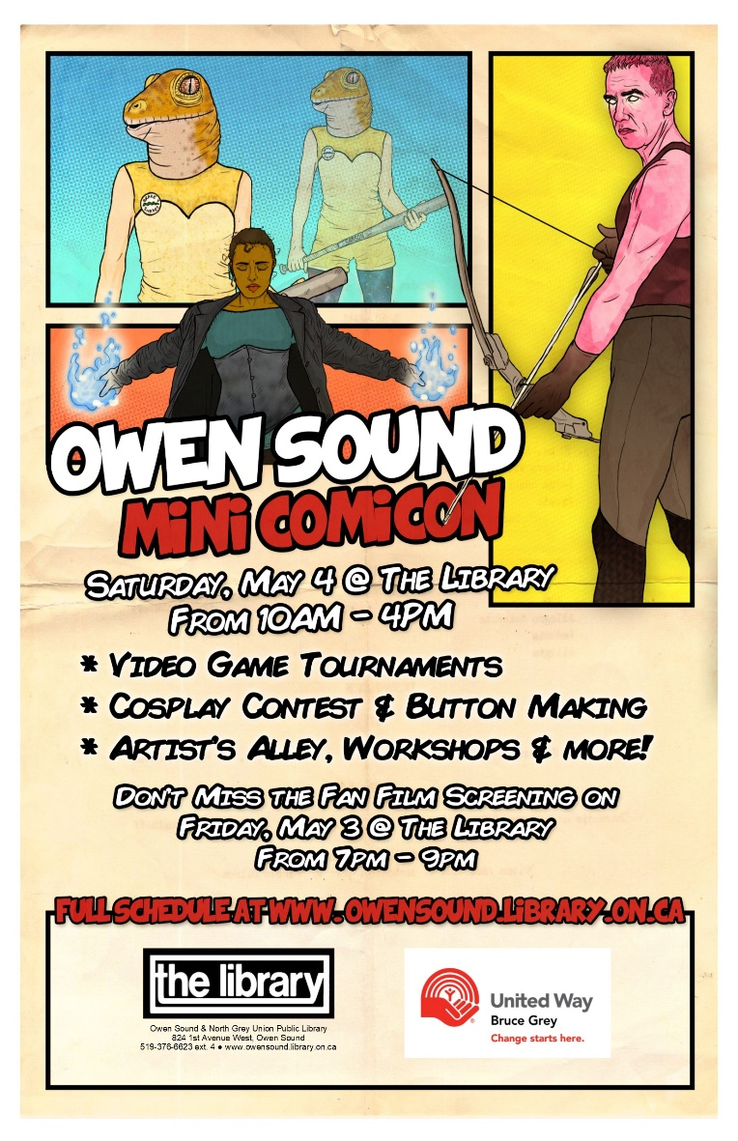
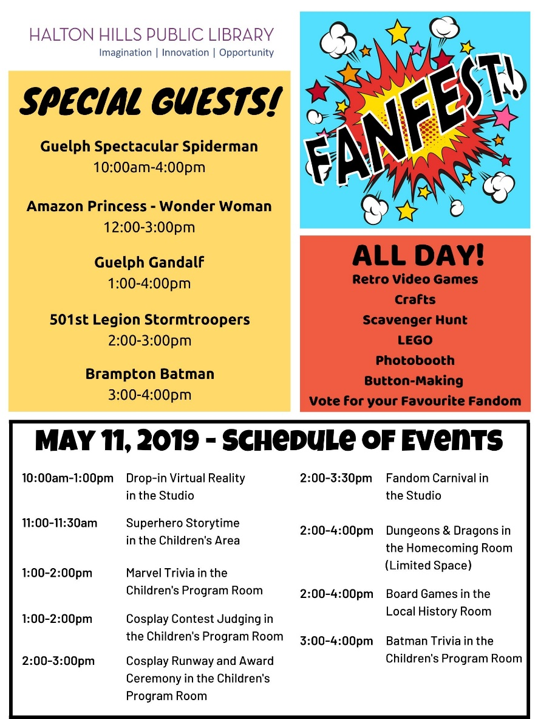

Slide 3
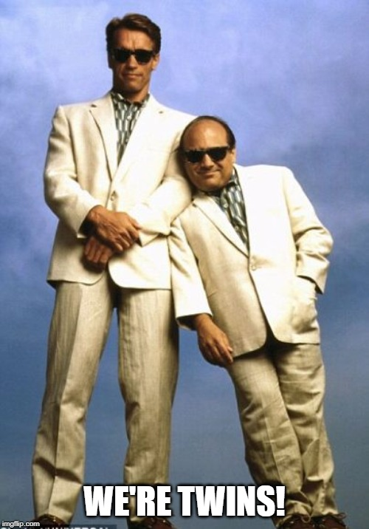
Library Snapshots
Halton hills
Bruce county
Owen sound north grey
RESIDENTS
LIBRARIES
CARD HOLDERS
PHYSICAL CIRC.
PROGRAMS
PROGRAM ATTENDANCE
62,000 66,491 40,011
2 17 1
42,459 28,234 11,503
522,116 429,261 329,021 1,715 2,607 437
25,271 23,275 10,027

Slide 4
Connecting to Strategic plans
Responding to Community Needs
Innovative and Engaging Programming
Offered something different from the regular schedule of programs
Drew well beyond usual program attendance
Hosted a variety of events simultaneously
Community interest in fandom-related programming
Planned with input from the community
Programming for Target Audiences
Families, adults, and teens
Awareness of Library as a Community Asset
Create opportunities for community partnerships
Opportunities for local business and vendors to participate
Draw attention to non-traditional library collections and services

Slide 5
Event planning overview
Months to Event | Items to Address
6 | Begin meetings of event committee with library and administration staff
5 | Tentative event outline and event schedule created Marketing plan created
4 | Contact/book special guests and vendors
3 | Put out media release All other promotion is in place/released
2 | Confirm all guests and vendors Finalize schedules for events, staff time/duties, physical spaces
0
… or more!

Slide 6
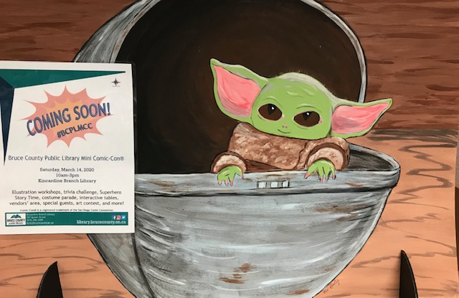
marketing
Logo
Tried and true
Thinking outside the box
Timing

Slide 7
Budget – Owen Sound
Expenses
Café snacks | $145
Comics | $300
Breadwinner | $285
Toys for cosplay prizes | $10
Pizza for volunteers | $105
Cosplay prizes | $15
Revenue
Donations | $85
Food Sales | $165
Tenneco Donation | $300
Chip sales to staff | $25
Staff Time
Day-of Staff | 8 hours * 3 staff
Planning | 28 hours * 3 staff

Slide 8
Budget – Halton Hills
Expenses
Activities
Fandom carnival supplies | $20
Buttons | $30
Crafts
Supplies | $15
Printing | $10
Special Guests
Batman | $200
Prizes
Cosplay contest | $40
Trivia contest | $20
Staff Time
Preparation (2 staff) | Jodie: 15 hours Other staff: 5 hours
Day of event (6 staff) | 7 hours * 6 staff

Slide 9
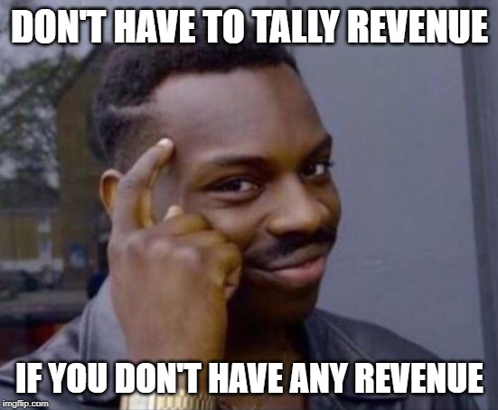
Budget – Bruce County
Expenses
Performers
Brampton Batman | $500
Face painting | $180
Prizes
Art contest | $30
Door prize | $70
Advertising
Facebook | $25
Activities
Slime | $100
Crafts | $170
Button supplies | $80
Misc
Decorations | $70
Food | $30
Staff Time
6 staff x 20 hours = 120 hours
Revenue

Slide 10
Setting it all up
Do some setup done the night before!
Staff come in early to finish setup, meet with vendors/partners
Staff organization:
Staff and volunteers are scheduled in specific areas
Break coverage schedule
Encourage staff to wear cosplay/fandom attire
Signage around the building

Slide 11
Event schedule– Halton Hills
All-Day Activities
Retro Video Games
Crafts
Scavenger Hunt
LEGO
Photobooth
Button-Making
Vote for your Favourite Fandom
Time | Event
10-1 | Drop-in Virtual Reality
11-11:30 | Superhero Storytime
1-2 | Marvel Trivia
 | Cosplay Contest Judging
2-3 | Cosplay Runway
2-3:30 | Fandom Carnival
2-4 | Dungeons and Dragons
 | Board Games
3-4 | Batman Trivia
Special Guests
Guelph Spectacular Spiderman
Amazon Princess – Wonder Woman
Guelph Gandalf
501st Legion
Brampton Batman

Slide 12
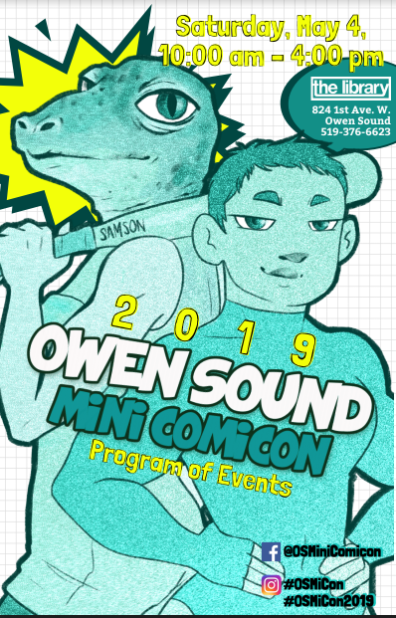
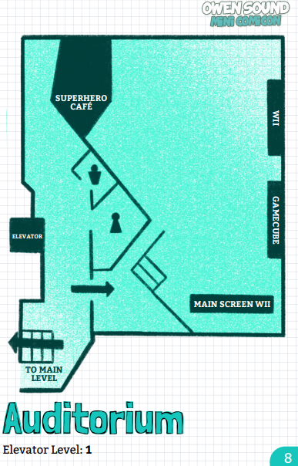
Event schedule – Owen Sound North Grey
Time | Event (Workshops)
11–11:45 | D&D: Homebrew Your Own Adventure
12–12:45 | Beginners Kanji with Mana
1–1:45 | Stuffies with Sharon
2–2:45 | Wig Styling and Make-up Basics with Laura
Time | Event
10-4 | Artist’s Alley
 | Superhero Café
10-3 | Owen Sound Ghostbusters
 | Button Stand
 | Paper Crafts
 | Kids’ Crafts
 | Prize Draws
 | Dr. Frankenstein’s Toy Workshop
 | Scenic City Games
 | Face Painting
 | Photo Booth
10-2:30 | Videogame Tournament
3-4 | Cosplay Showcase

Slide 13
Event schedule– Bruce county
All-Day Activities
Vendor’s Area
Green Screen
Scavenger Hunt
Slime Workshop
Bean Bag Toss
Button Making
Brampton Batman
Time | Event
10 | Story Time
 | Wizard Workshop
10:30-3:30 | Face Painting
11 | Adobe Illustrator Workshop
12 | Cosplay Demo
12:30-1:30 | iPad Comic Strips
1 | Illustration
2:00-3:30 | Trivia Challenge
3 | Story Time
 | Wizard Workshop
3:30 | Costume Parade with Batman
4 | Art Contest Draw
 | ComicCon Prize Draw

Slide 14
Evaluation
We Asked:
Highlights / favourite events
Things to add in the future
How it affects our community
How did you learn about the event
Would you be interested in participating in future events, and how
General comments
Evaluations:
Electronic, via Facebook and Survey Monkey
Postmortem with staff and volunteers

Slide 15
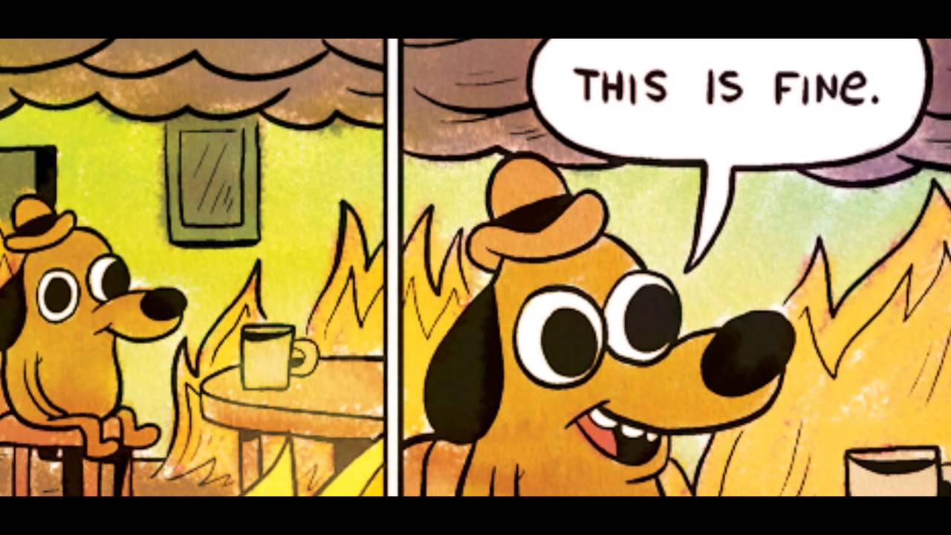
Things we learned from our mistakes adventures
Owen Sound North Grey
No more Friday evening films
Fewer meetings with volunteers
Consider rescheduling cosplay for the afternoon
Needs more volunteers
Trivia does not need to last an hour
Don’t skimp on the pizza
No one likes Sprite
Bruce County
Re-examine or create policies as needed
Volunteer policies – what can they do?
Room capacity issues
Afternoon anchor event
Halton Hills
More staff involved in the planning stage
Examine library policies (ex: vendors)
Scheduling event on free comic book day

Slide 16
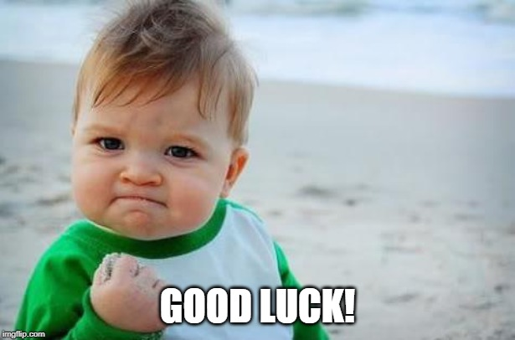
Now it’s your turn!
The Goal: take home a plan you can sell to your library director on how AMAZING this event will be!
Use the templates provided to outline a fan event for your library
Work together at your table to brainstorm ideas
We’ll re-group in 20 minutes to share our collective ideas

Slide 18
Question & answer
JODIE MANDARINO
jmandarino@haltonhills.ca
NANCY KUHL nkuhl@brucecounty.on.ca
JEREMY CLARK jclark@brucecounty.on.ca
Nadia Danyluk ndanyluk@owensound.library.on.ca SHARON WAGENAAR swagenaar@owensound.library.on.ca

